Slide 1


MY SELF : DEVANSHU CHAUHAN
A PRESENTATION BY DEVANSHU CHAUHAN

Slide 2

AGENDA
Who am I ?
What I Love ?
What I Hate ?
Swot Analysis

Slide 3
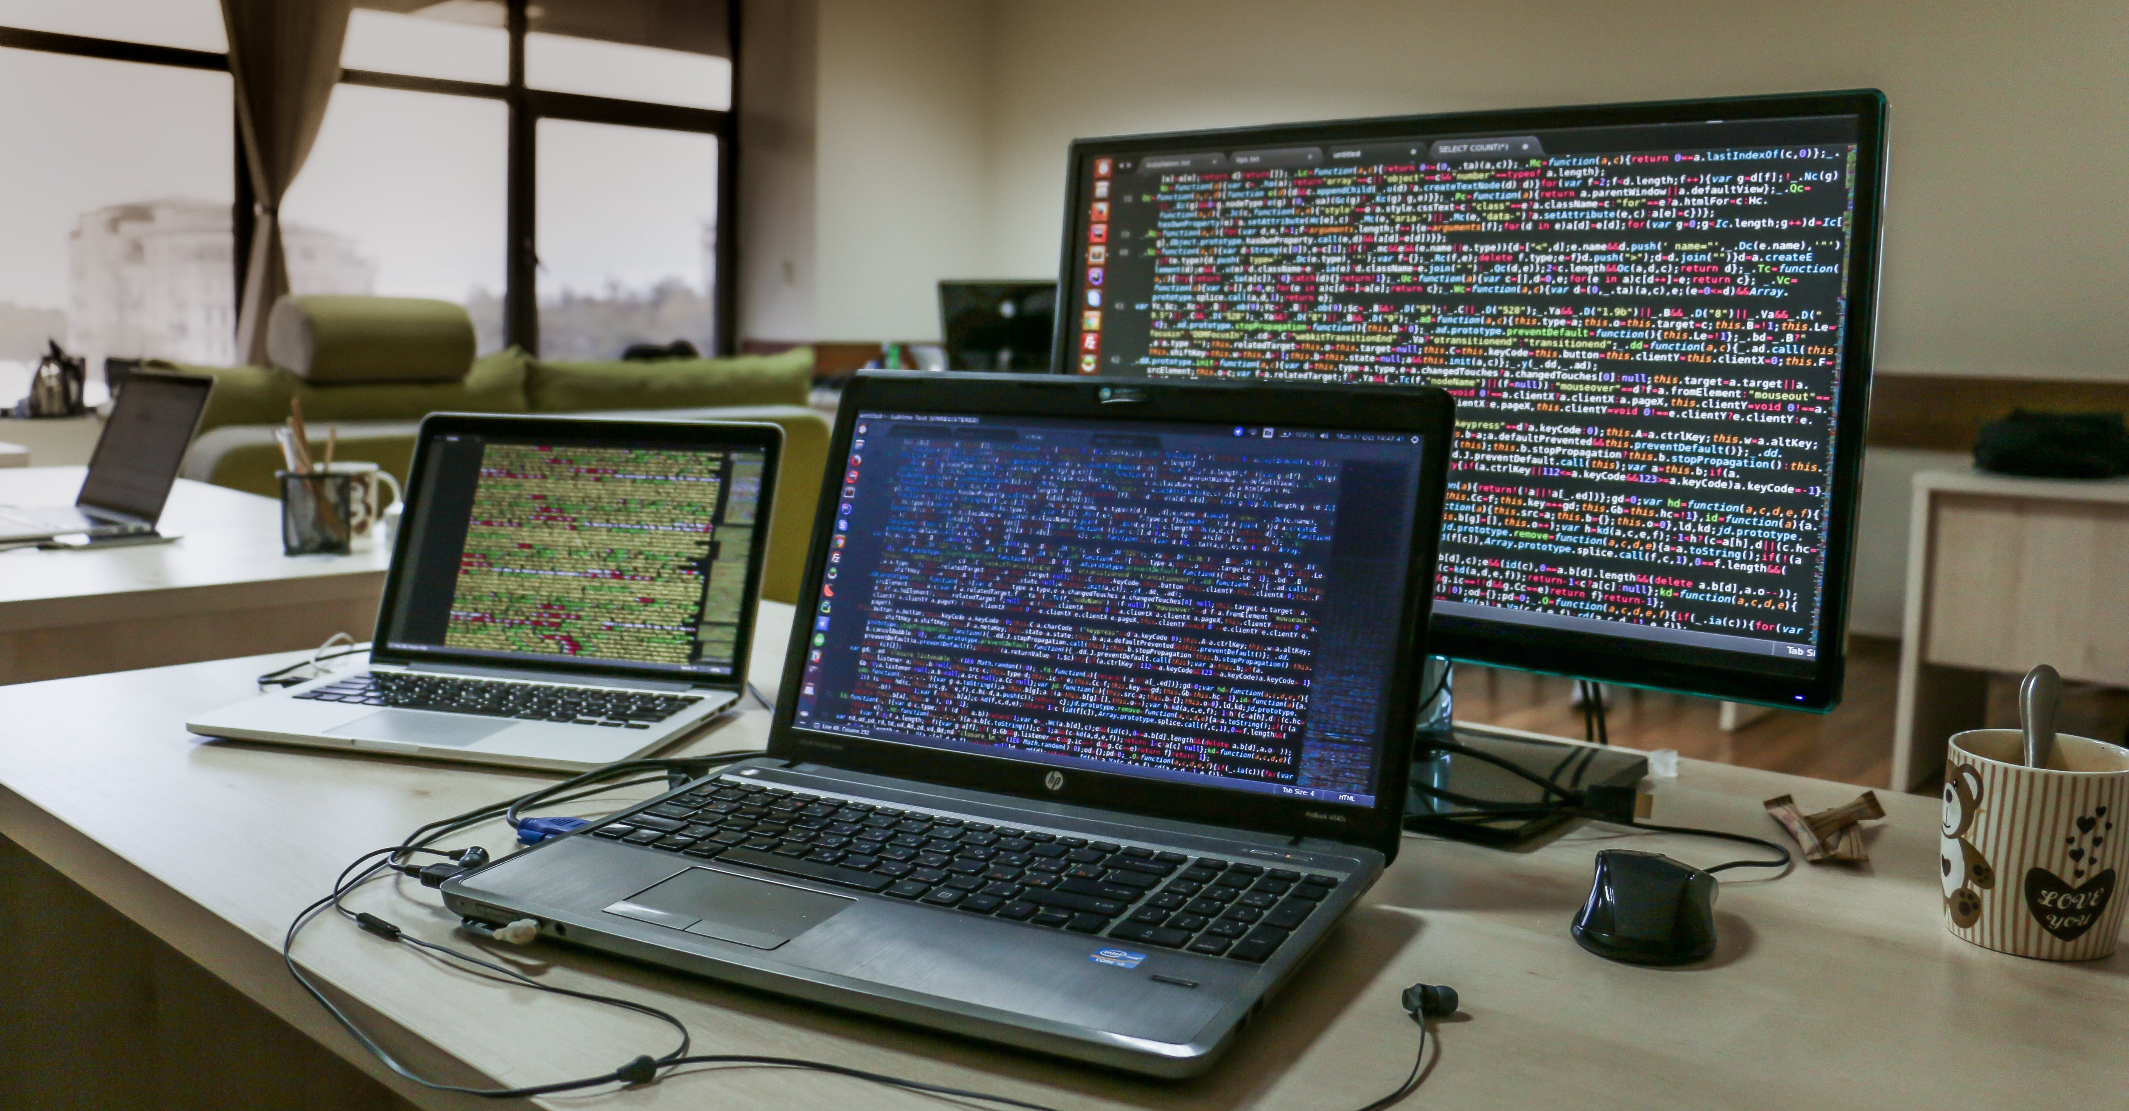


Devanshu Chauhan [Software Engineer]
As a Software Engineer , I am #Code Curious means always excited to explore and understand new lines of code like a detective investigating a mystery.
But with a Curiosity for Coding , I am very Composed and Calm person in both Normal Life and professional life.

Slide 4



What I Love?
First of all I love Myself because I always enjoy my own company and I believe that I am the best company for myself. [#SelfLove]
In my free time, I like to watch movies of different genres because I am moody person but I love comedy and sci-fi movies the most.

Slide 5


What I Hate?
I hate it when plans get canceled at the last minute.
I hate sound of the horn.
I hate when my internet connection is slow.
This Photo by Unknown author is licensed under CC BY-NC.

Slide 6



SWOT
Strength
Weakness
Opportunity
Threat
Logical thinker
Friendly
Very Humble
Grounded
Can not do Multitasking​
Not expressive​
Take Everything Lightly​
Scope of AI ML ​
High Paying Jobs in Web Development ​
New Jobs Like Prompt Engineer​
ChatGPT and Other AI Tools​
This Photo by Unknown author is licensed under CC BY-NC-ND.

Slide 7
Believe in
" Be kind, Stay Positive, and believe in the power of continuous learning."

Slide 8
Thank You

